Slide 1
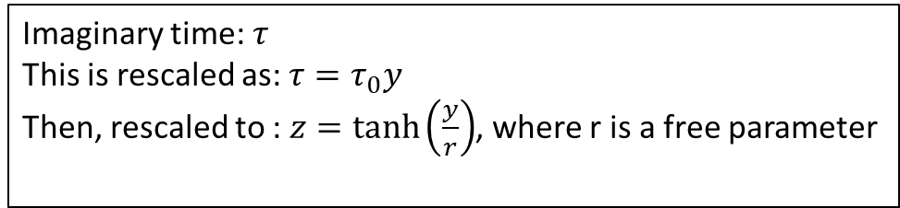

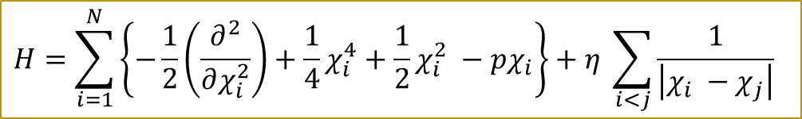
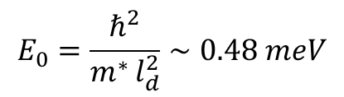
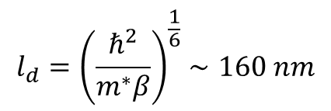
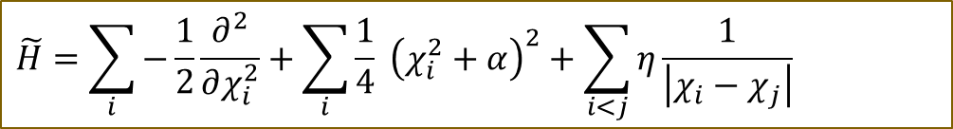
Model Hamiltonian:
P = 0 in our case
$$H=\sum_{i=1}^{N}{\left\{−\frac{1}{2}\left(\frac{∂^{2}}{∂χ_{i}^{2}}\right)+\frac{1}{4}χ_{i}^{4}+\frac{1}{2}χ_{i}^{2} −pχ_{i}\right\}+η \sum_{i<j}{\frac{1}{\left|χ_{i} −χ_{j}\right|}}}$$
$$\tilde{H}=\sum_{i}{−\frac{1}{2}\frac{∂^{2}}{∂χ_{i}^{2}}+\sum_{i}{\frac{1}{4} {\left(χ_{i}^{2}+α\right)}^{2}+\sum_{i<j}{η\frac{1}{\left|χ_{i}−χ_{j}\right|}} }}$$
Dimensionless form:
We set the dimensionless interaction strength to a number close to the experimentally indicated value: $η=20$
$$l_{d}={\left(\frac{ℏ^{2}}{m^{∗}β}\right)}^{\frac{1}{6}}∼160 nm$$
Imaginary time: $τ$
This is rescaled as: $τ=τ_{0}y$
Then, rescaled to : $z=\tanh\left(\frac{y}{r}\right)$, where r is a free parameter
$$E_{0}=\frac{ℏ^{2}}{m^{∗ }l_{d}^{2}}∼0.48 meV$$
$$η=\frac{l_{d}}{a_{B}}∼18.8$$

Slide 2
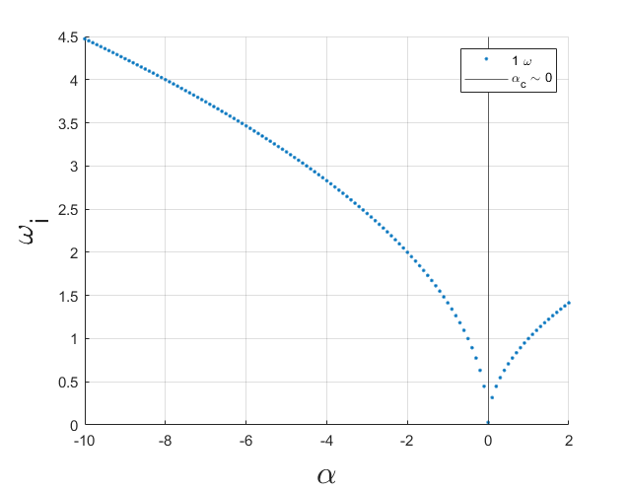
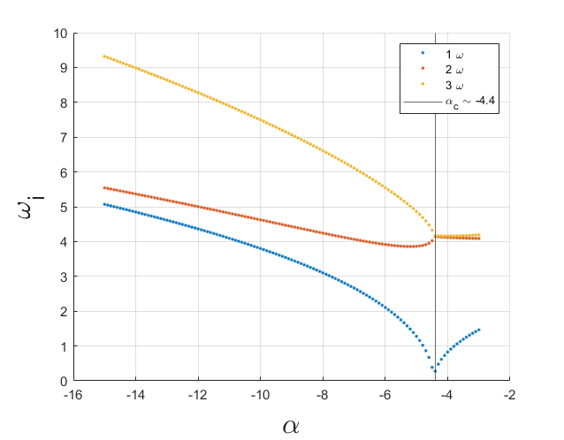
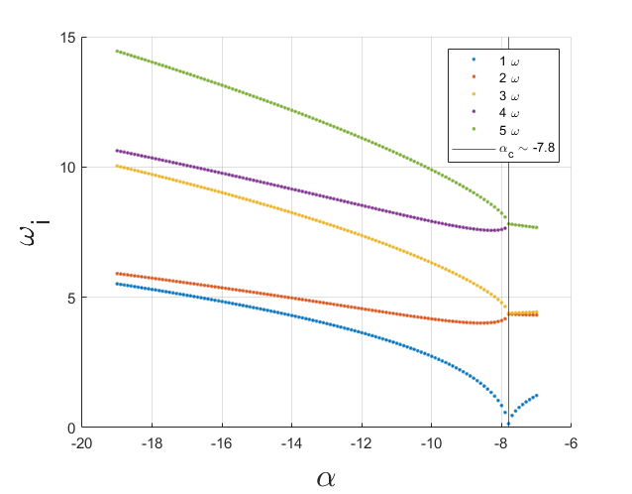
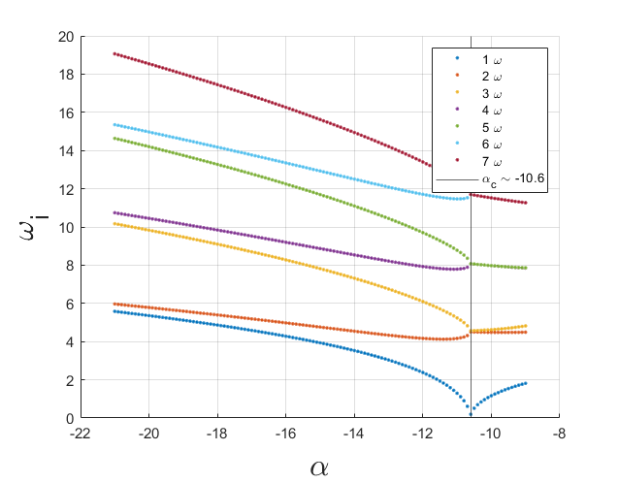
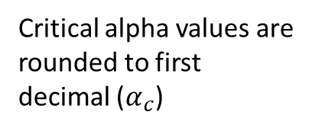
Classical Frequencies
1 p:
3 p:
5 p:
Critical alpha values are rounded to first decimal ($α_{c}$)
7 p:

Slide 3
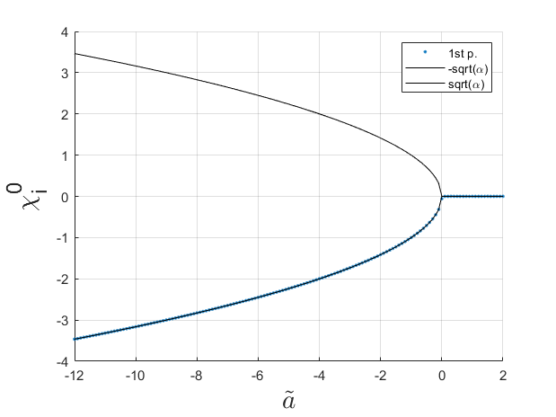
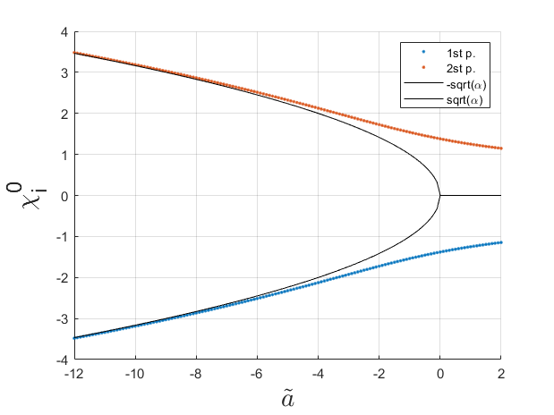
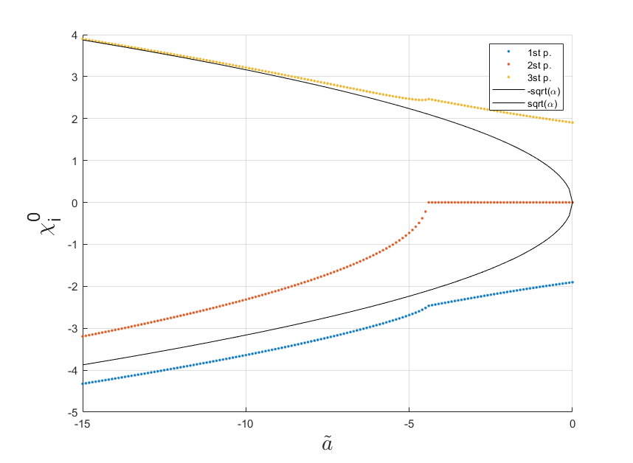
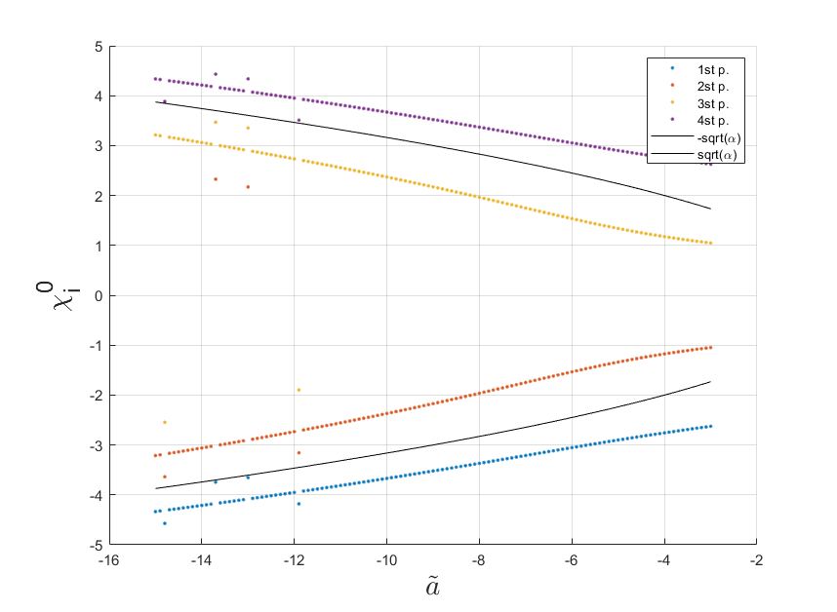
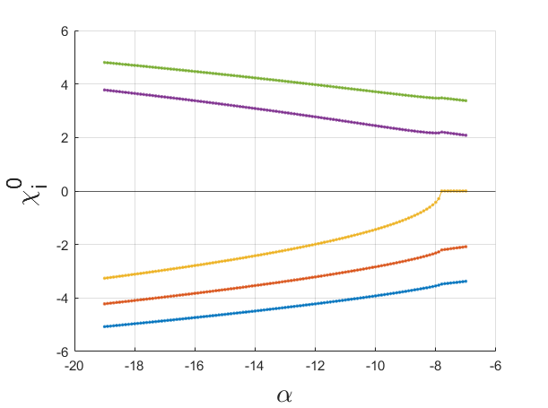
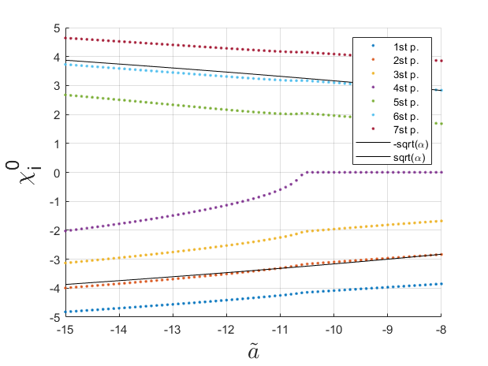
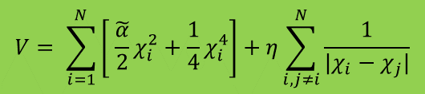
Equilibrium poisitions
$±\sqrt{α }$is the analytical solution for potentintial minima in the case of 1 particle
1 part.
2 part.
3 part.
4 part.
5 part
7 part
Minima finding in the following potential:
$$V= \sum_{i=1}^{N}{\left[ \tilde{\frac{α}{2}}χ_{i}^{2}+\frac{1}{4}χ_{i}^{4}\right]+η\sum_{i,j≠i}^{N}{\frac{1}{|χ_{i}−χ_{j}|}}}$$

Slide 4
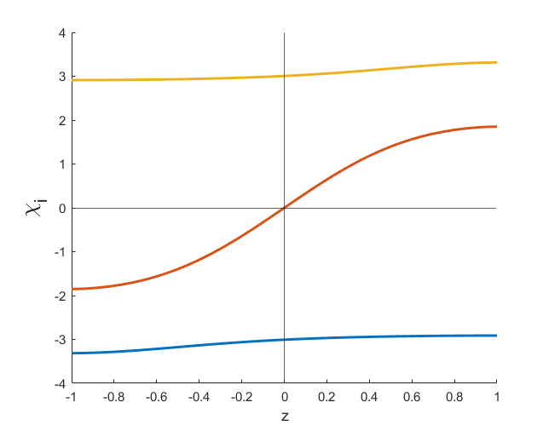
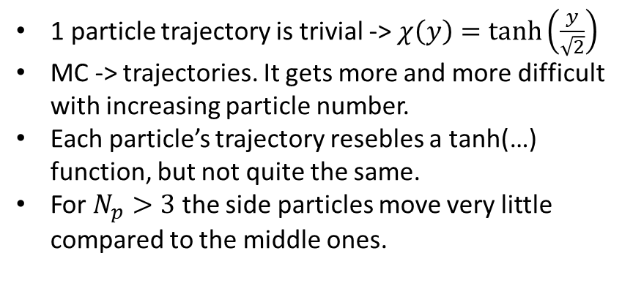

Trajectories
3 particle tajectories for a specific alpha
1 particle trajectory is trivial -> $χ\left(y\right)=\tanh\left(\frac{y}{\sqrt{2}}\right)$
MC -> trajectories. It gets more and more difficult with increasing particle number.
Each particle’s trajectory resebles a tanh(…) function, but not quite the same.
For $N_{p}>3$ the side particles move very little compared to the middle ones.
$$χ_{2}^{middle}$$

Slide 5
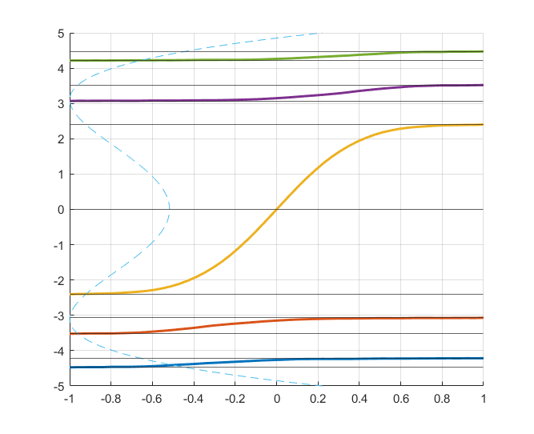
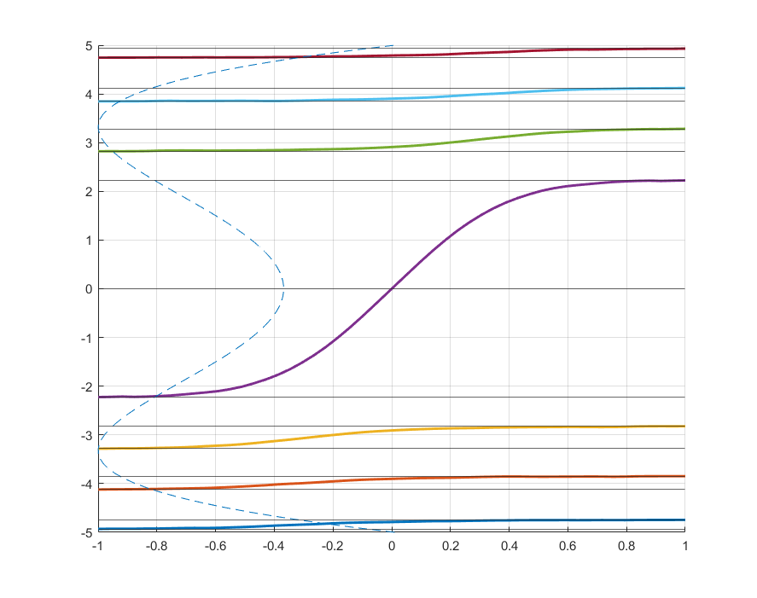

5 p:
7 p:
Potential
$χ_{0}^{i}$& $χ_{f}^{i}$
Trajectories

Slide 6
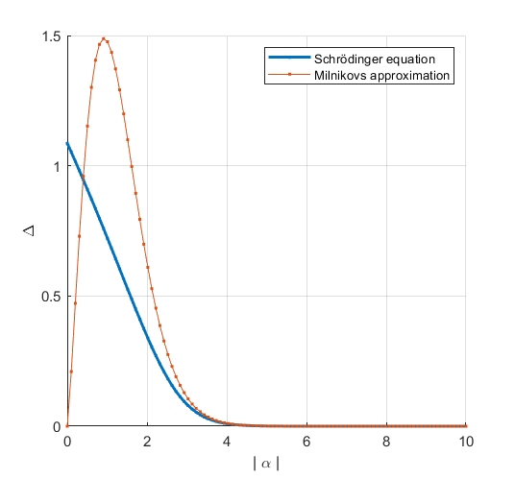
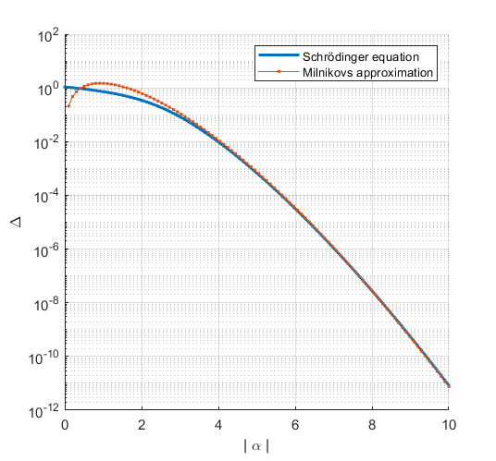
Tunneling splitting – 1 particle ED & DMRG & Milnikov
For 1 particle ED and DMRG gives the same result
~2.95

Slide 7
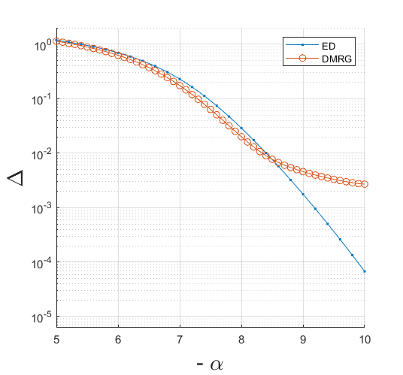
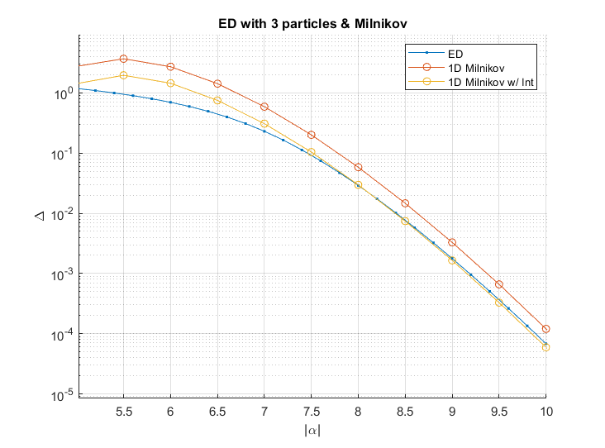
Tunneling splitting – 3 particle ED & DMRG & Milnikov
For now theres a slight mismatch between DMRG and ED for 3 particles
Quartic potential approx
No approx.

Slide 8
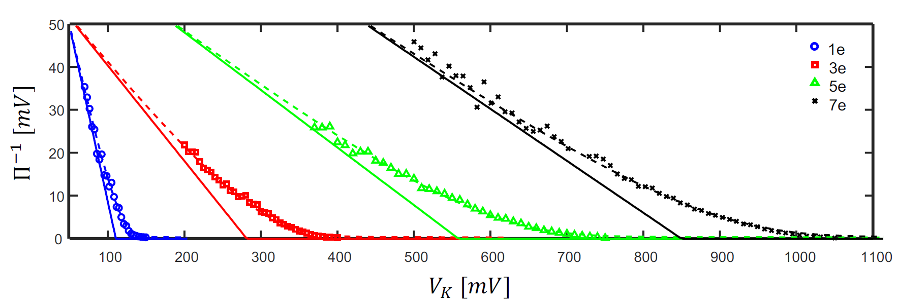
Experimental Data – Shahal

